Slide 1
U-Net: Convolutional Networks for Biomedical Image Segmentation
-Tushar Sarkar
1911050

Slide 2
Introduction
The architecture consists of a contracting path to capture context and a symmetric expanding path that enables precise localization.
Segmentation of a 512x512 image takes less than a second on a recent GPU. Therefore the network is fast.
In many visual tasks, especially in biomedical image processing, the desired output should include localization, i.e., a class label is supposed to be assigned to each pixel.

Slide 3
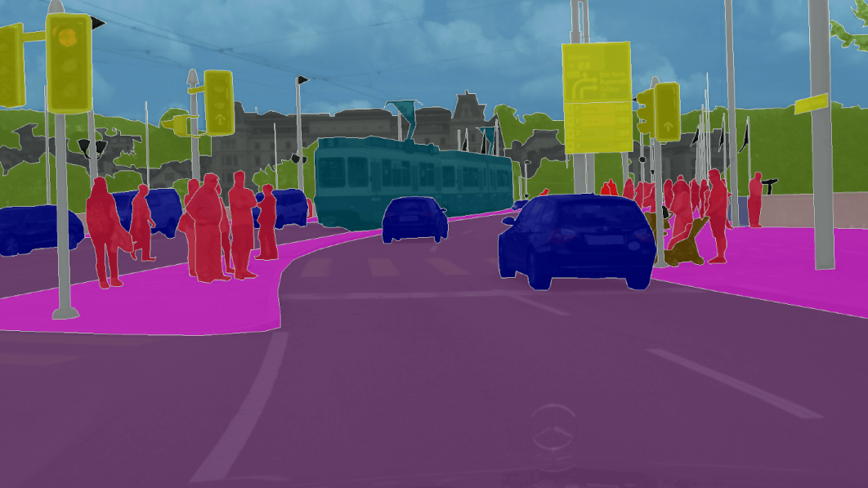
Architecture
The main idea in this paper is to supplement a usual contracting network by successive layers, where pooling operators are replaced by upsampling operators. Hence, these layers increase the resolution of the output. In order to localize, high resolution features from the contracting path are combined with the upsampled output. A successive convolution layer can then learn to assemble a more precise output based on this information.

Slide 4
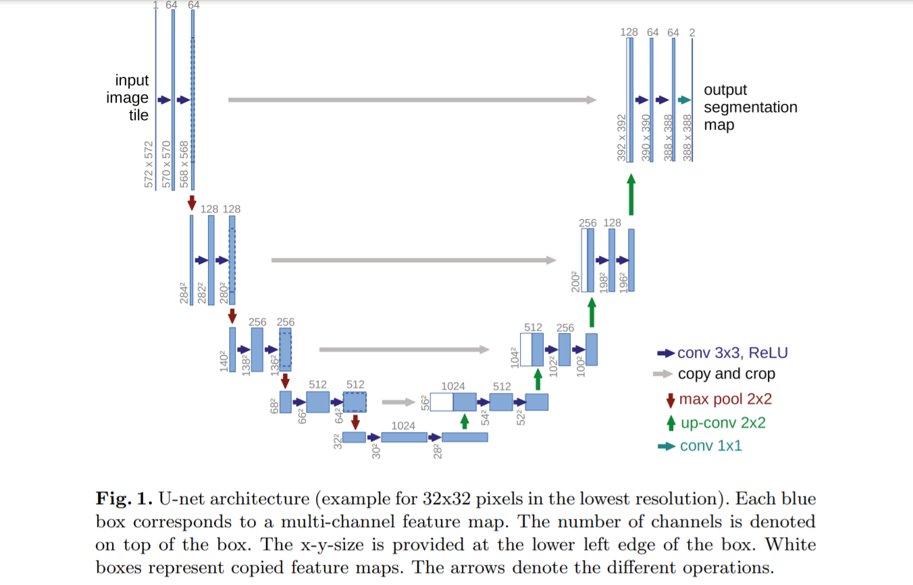

Slide 5
Training
Trained in Caffe Framework
Stochastic gradient descent(SGD) is used as optimizer
The energy function is computed by a pixel-wise soft-max over the final feature map combined with the cross entropy loss function

Slide 6
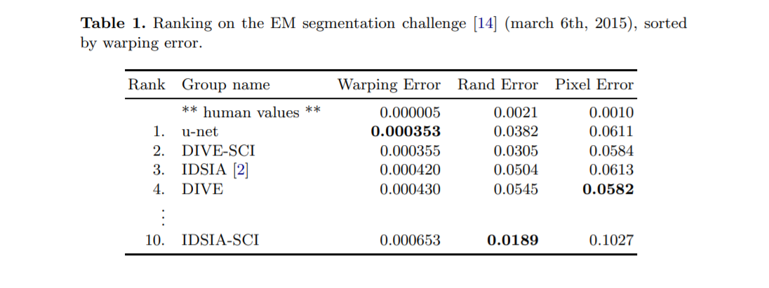
Data augmentation is essential to teach the network the desired invariance and robustness properties, when only few training samples are available.
The displacements are sampled from a Gaussian distribution with 10 pixels standard deviation. Per-pixel displacements are then computed using bicubic interpolation.

Slide 7
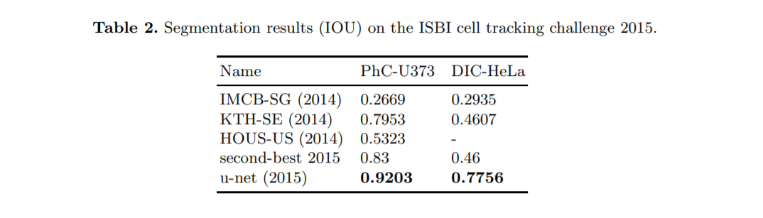
Results and Conclusion
The u-net architecture achieves very good performance on very different biomedical segmentation applications

Slide 8
Bibliography
Up Sampling - An Efficient Upsampling Technique for Images and Videos
ReLU - https://paperswithcode.com/method/relu
SGD - https://arxiv.org/pdf/1609.04747.pdf

Slide 9
Strategy for implementation
Training data - City Scapes dataset with 2975 images for training
Testing - 500 images for testing
Novel idea - Insert Squeeze and Excitation blocks in between the layers and to also use NFNet as the backbone for the contracting path
Training will be on PyTorch Framework
Loss Function will be the same as used in the paper , i.e Cross -Entropy

